Slide 1
ENSE 470, Milestone 7
ByteThis Software
Taylor Petrychyn, Alwin Baby, and Konstantin Kharitonov
April 12, 2018

Slide 2
Dancing to Zebras

Slide 3
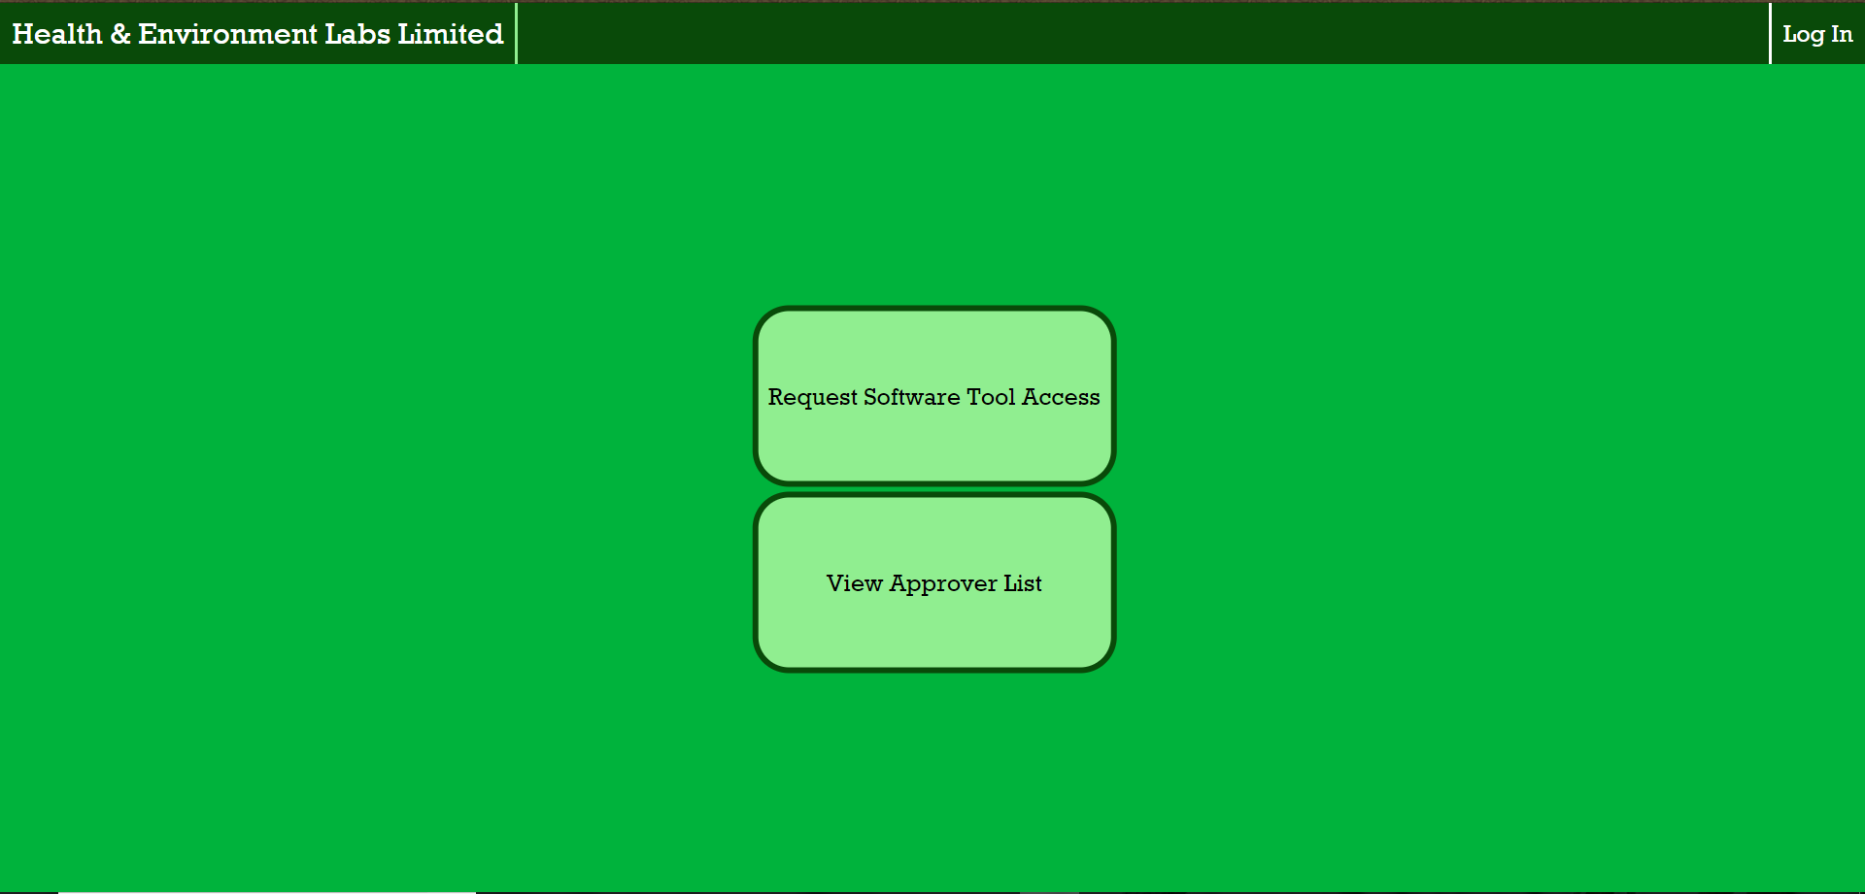

Slide 4
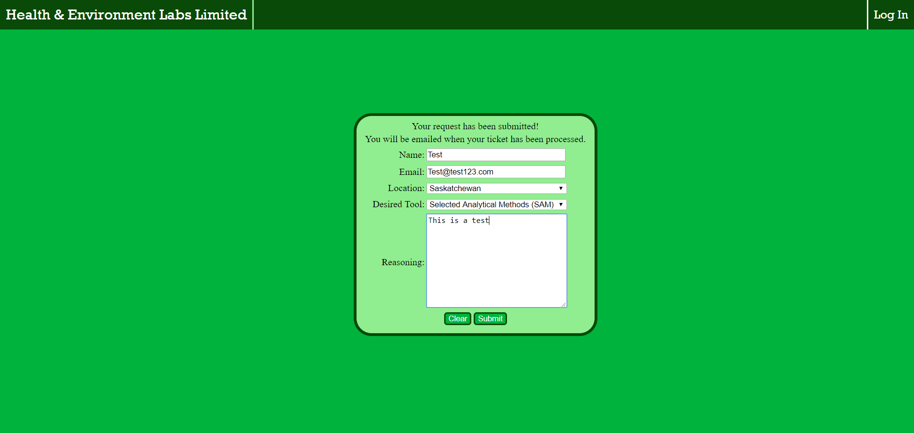

Slide 5
Team GitHub review
GitHub was readable and easy to understand
All the files were clearly named
Will be very easy to pickup where left off

Slide 6
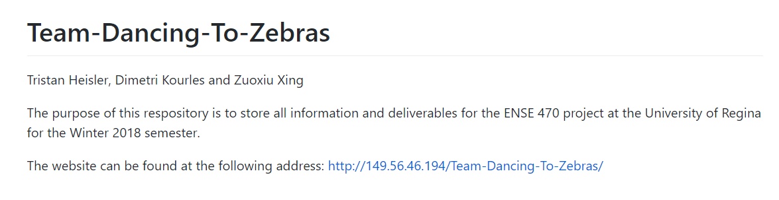
README file

Slide 7
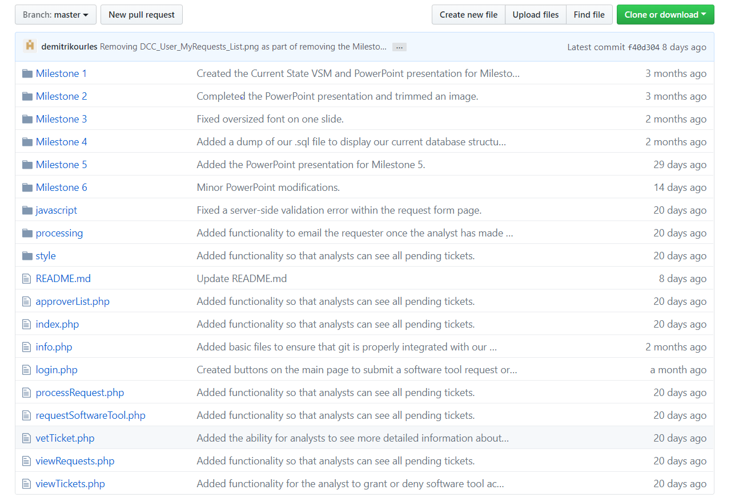

Slide 8
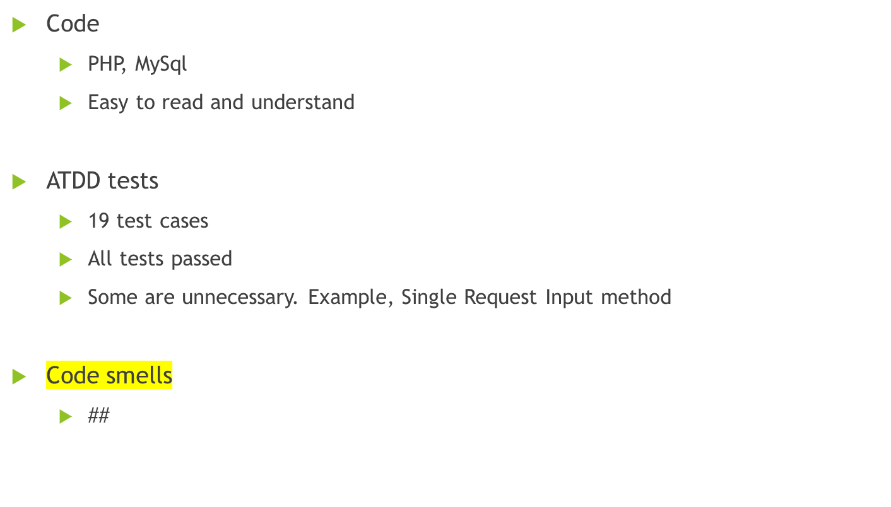
Refactor review (High-level focus)

Slide 9
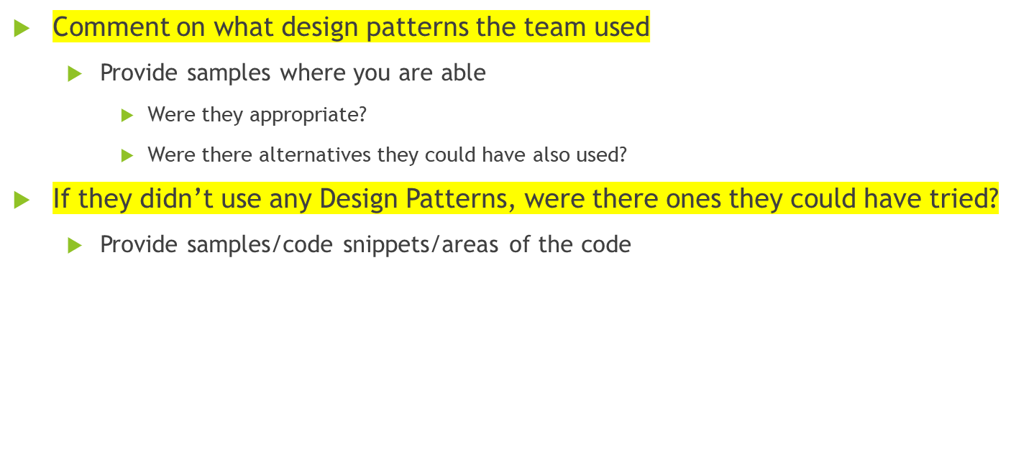
Design pattern discussion (High-level focus)

Slide 10
Reviewed team’s response
Questions?

Slide 11
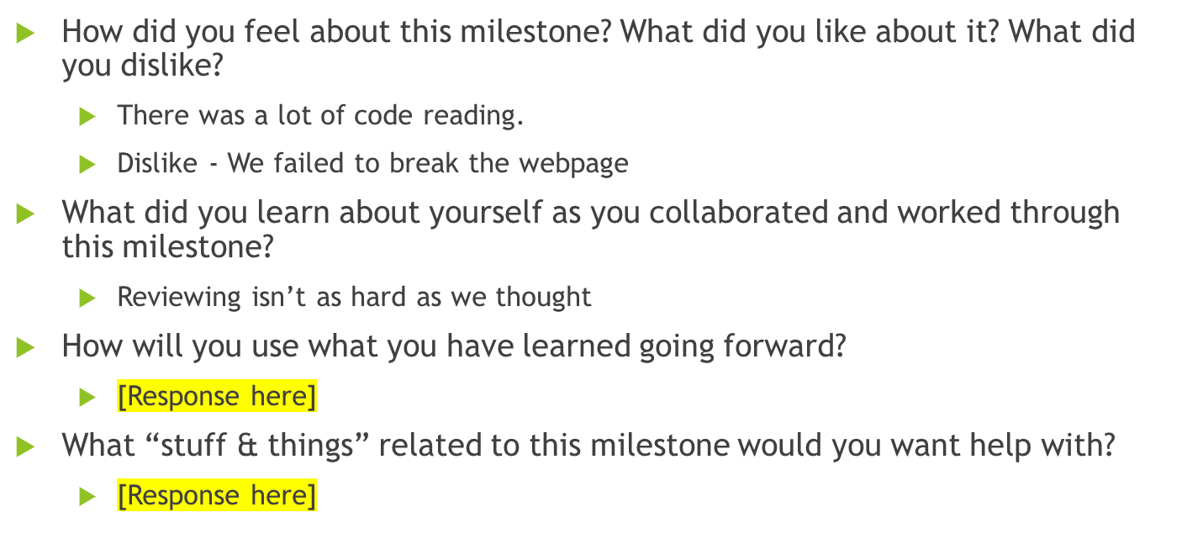
Group reflection

